Slide 1
Training GANs, DCGAN and CGAN
Víctor Uc Cetina
victoruccetina@gmail.com

Slide 2
Content
Training GANs
Training Deep Convolutional GANs
Conditional GAN

Slide 3
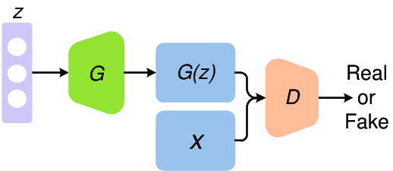
Training GANs
Phase 1.
We feed Gaussian noise to the generator to produce fake images. We concatenate an equal number of real images and train the discriminator. The discriminator’s weights are updated.
Phase 2.
We feed the GAN some Gaussian noise. The generated images are now labelled as real images and they are passed to the discriminator. The discriminator’s weights are not changed at this time, only the Generator’s weights.

Slide 4
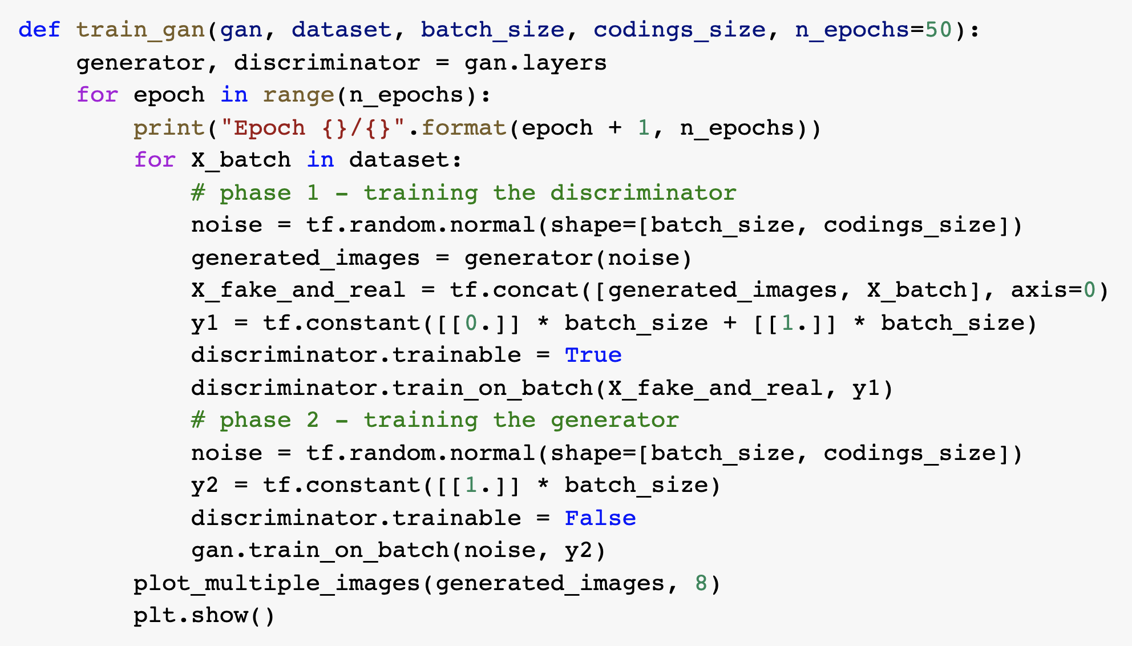
Training GANs - Code

Slide 5
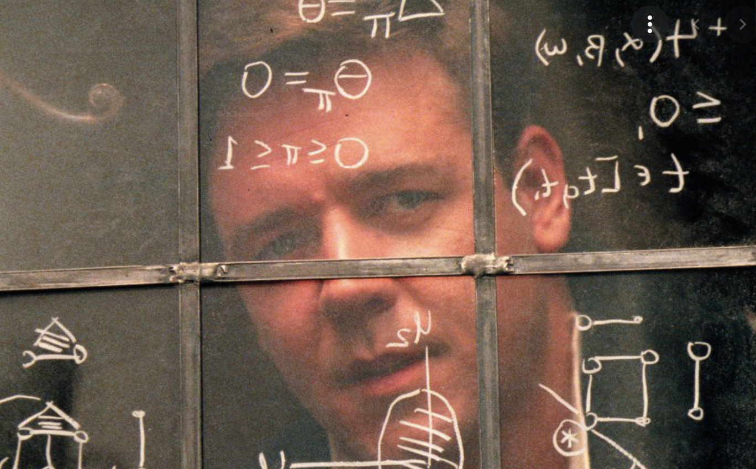
Nash Equilibrium
In game theory, the Nash equilibrium is the most common way to define the solution of a non-cooperative game involving two or more players.
In a Nash equilibrium, each player is assumed to know the equilibrium strategies of the other players and no player has anything to gain by changing only their own strategy.
A GAN can only reach a single Nash equilibrium when the generator produces perfectly realistic images, and the discriminator is forced to guess: 50% real, 50% fake.

Slide 6
The biggest difficulty: mode collapse
It occurs when the generator’s outputs gradually become less diverse.
Example:
The generator gets better at producing convincing shoes images than any other class.
The discriminator sees only fake images of shoes and will also forget to discriminate other classes.
Eventually when the discriminator manages to discriminate the fake shoes from the real ones, the generator will be forced to move to another class, for example, shirts.
The discriminator will follow focusing on discriminating shirts.
The GAN may gradually cycle across a few classes, never really becoming very good at any of them.

Slide 7
GANs are unstable
The generator and the discriminator are constantly pushing against each other. As a consequence of this, their parameters may end up oscillating and becoming unstable.
Training may begin properly, then suddenly diverge for no apparent reason.
GANs are very sensitive to hyperparameters and you may have to spend a lot of time fine-tuning them.

Slide 8
Solutions proposed so far
New cost functions, training strategies and ways to avoid mode collapse.
Experience replay.
It consists in storing the images produced by the generator in a buffer and training the discriminator using real images and fake images drawn from this buffer. Old images are gradually dropped.
Mini-batch discrimination.
It measures how similar images are across the batch and provides this statistic to the discriminator, so it can easily reject a whole batch of fake images that lack diversity.
Specific architectures that happen to perform well.

Slide 9
Training Deep Convolutional GANs (DCGAN)
Replace any pooling layers with strided convolutions (in the discriminator) and transposed convolutions (in the generator).
Use batch normalization in both the generator and the discriminator, except in the generator’s output layer and the discriminator’s input layer.
Remove fully connected hidden layers for deeper architectures.
Use ReLU activation in the generator for all layers except the output layer, which should use tanh.
Use leaky ReLU activation in the discriminator for all layers.

Slide 10
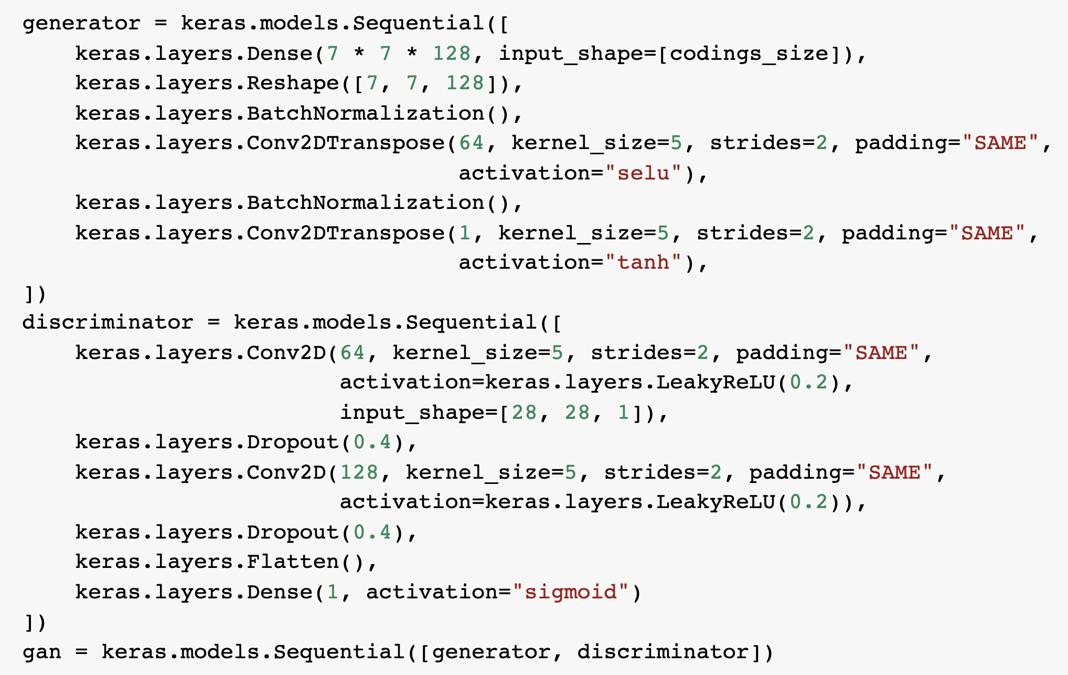
DCGAN code

Slide 11
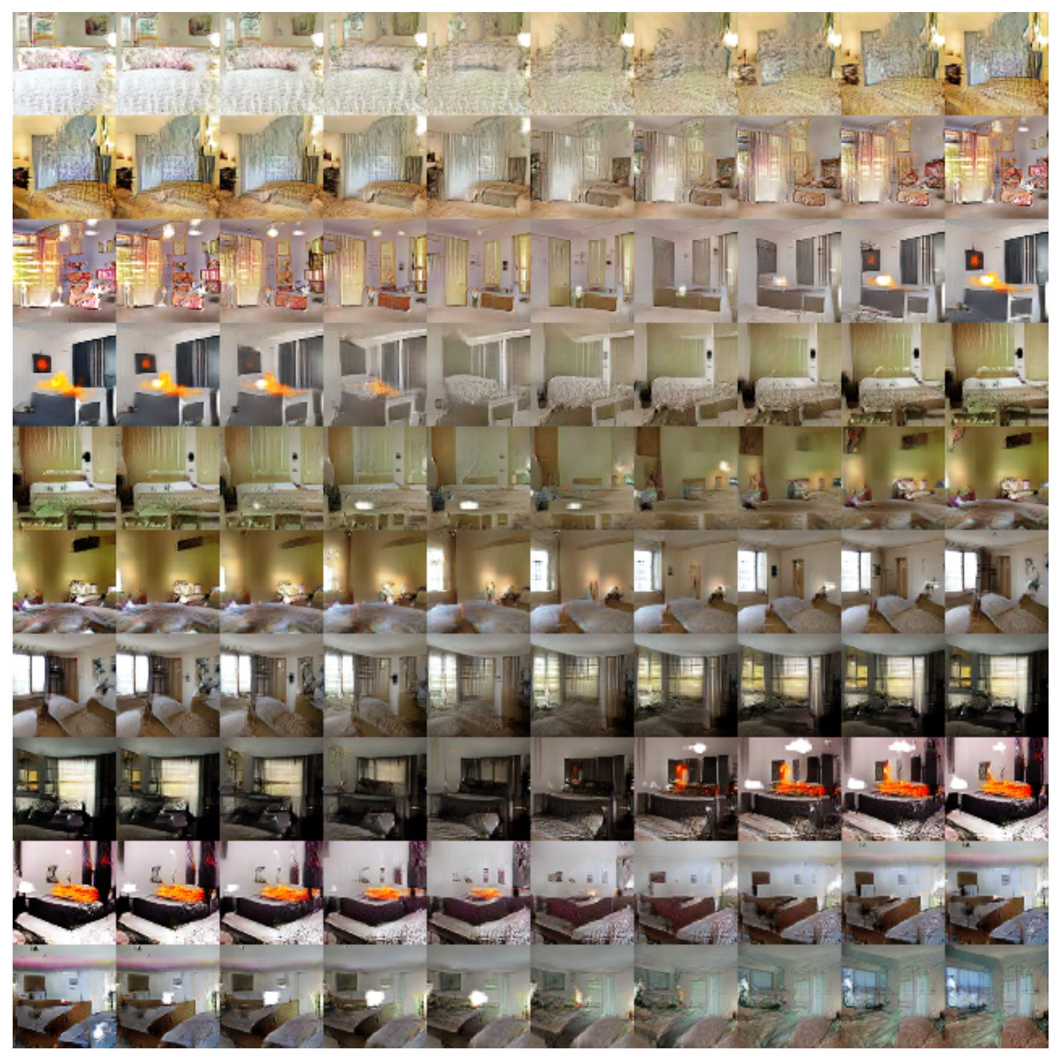
DCGAN Interpolation

Slide 12
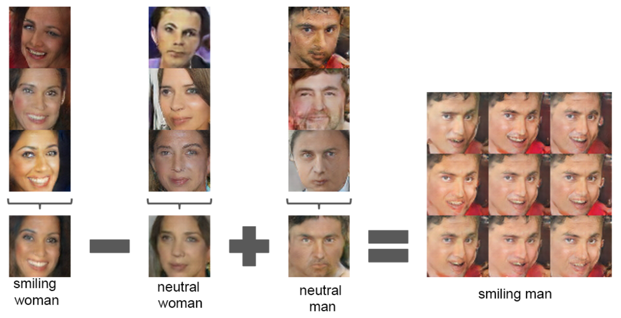
DCGAN Arithmetic

Slide 13
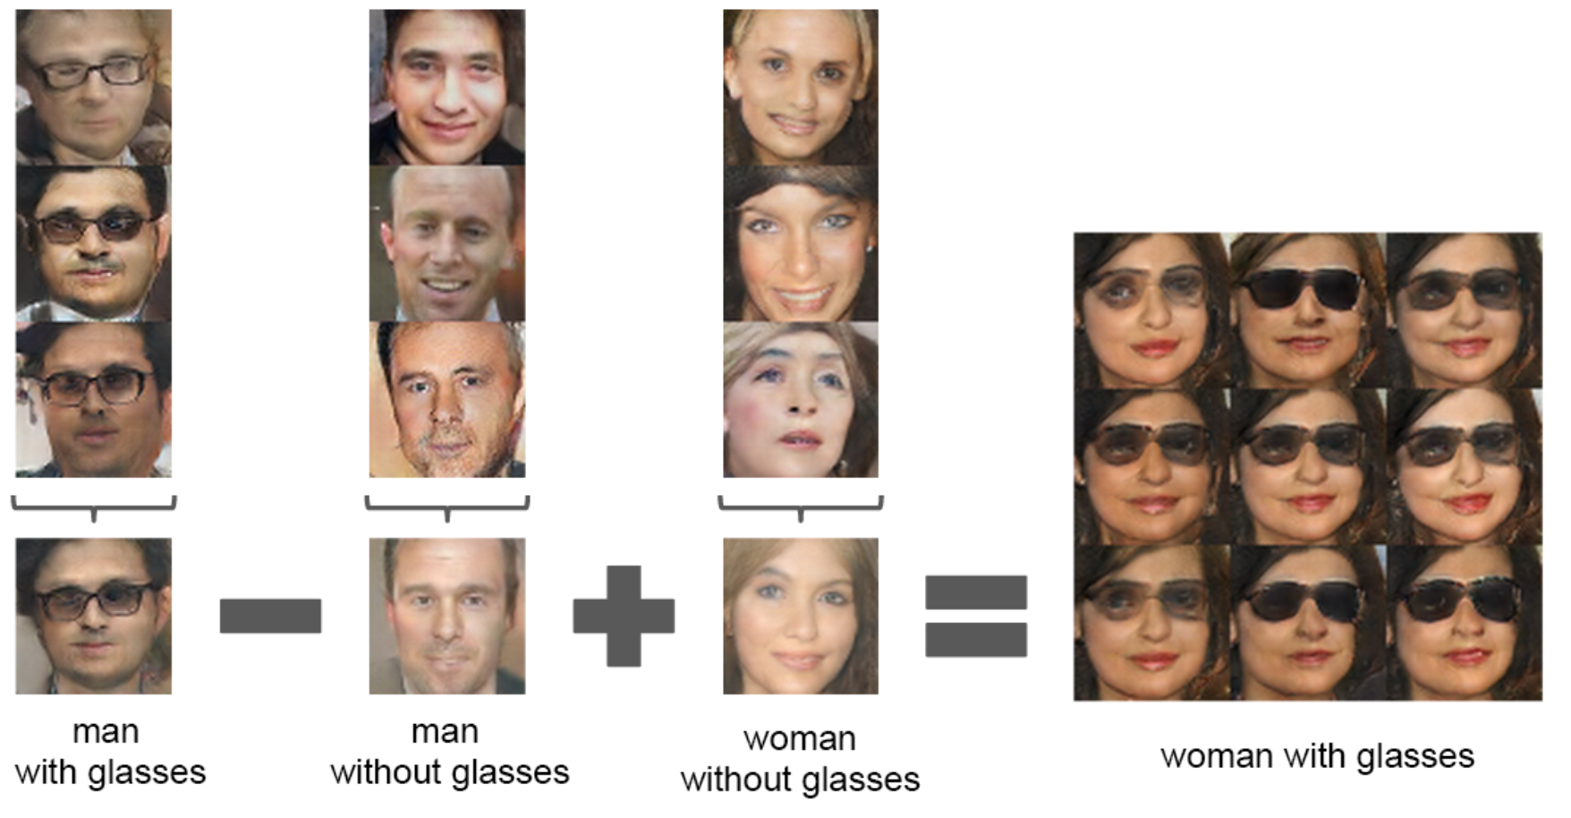
DCGAN Arithmetic

Slide 14
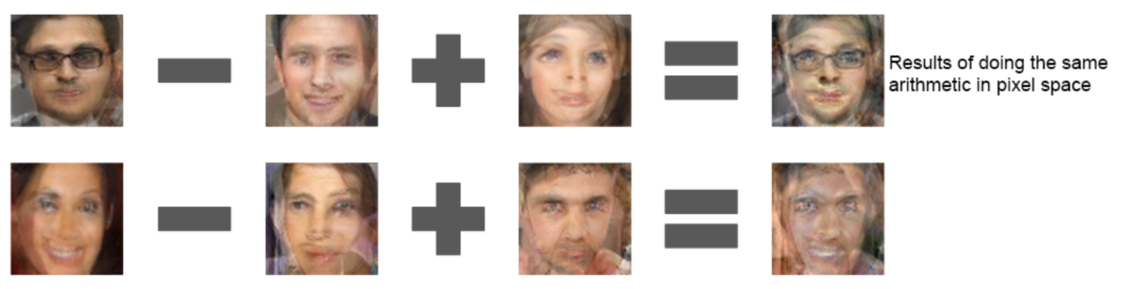
Pixel Arithmetic

Slide 15
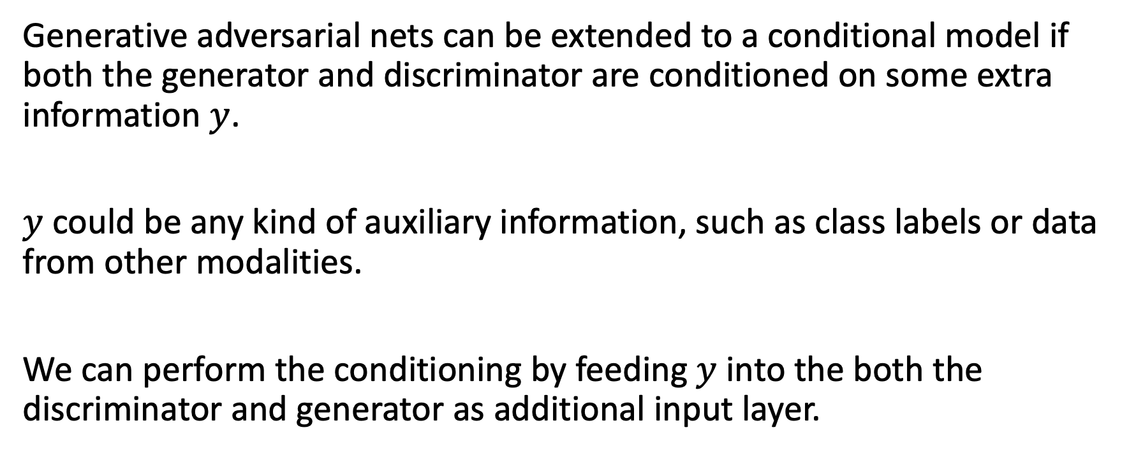
Conditional GAN
Generative adversarial nets can be extended to a conditional model if both the generator and discriminator are conditioned on some extra information $y$.
$y$ could be any kind of auxiliary information, such as class labels or data from other modalities.
We can perform the conditioning by feeding $y$ into the both the discriminator and generator as additional input layer.

Slide 16
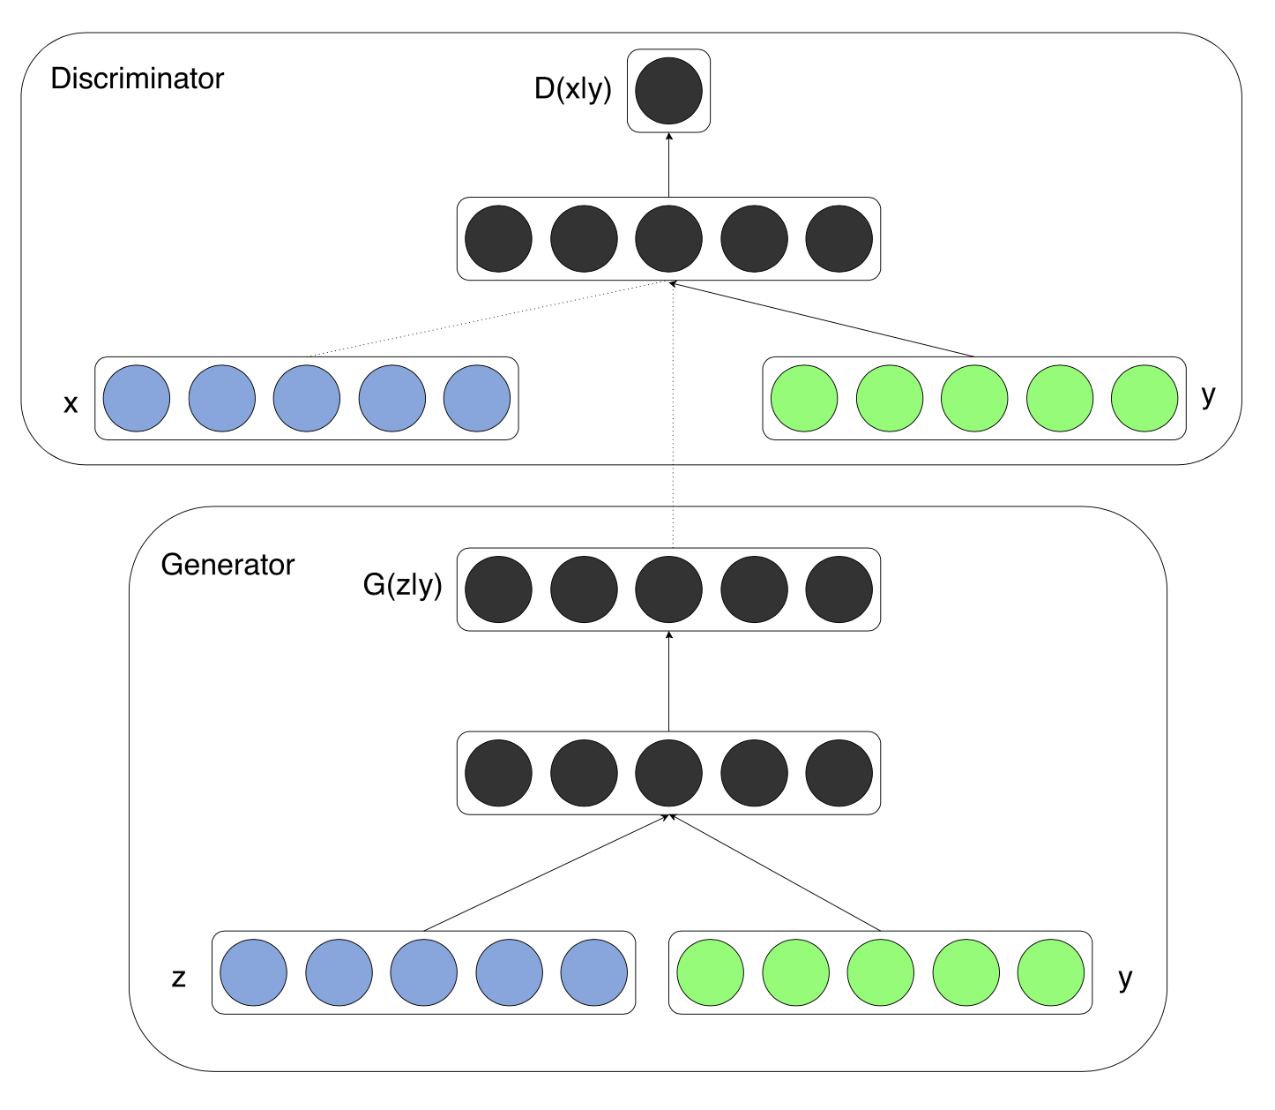
Conditional GAN - Architecture

Slide 17
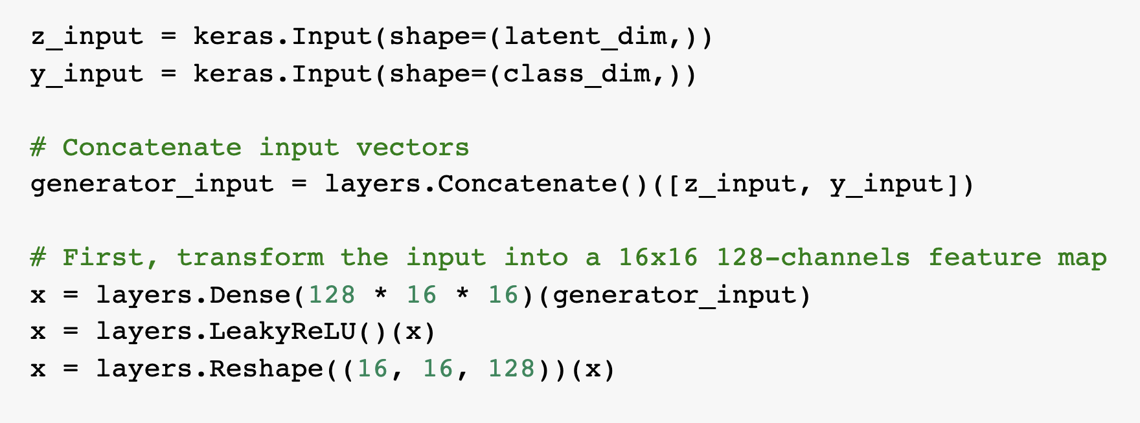
Conditional GAN Generator

Slide 18
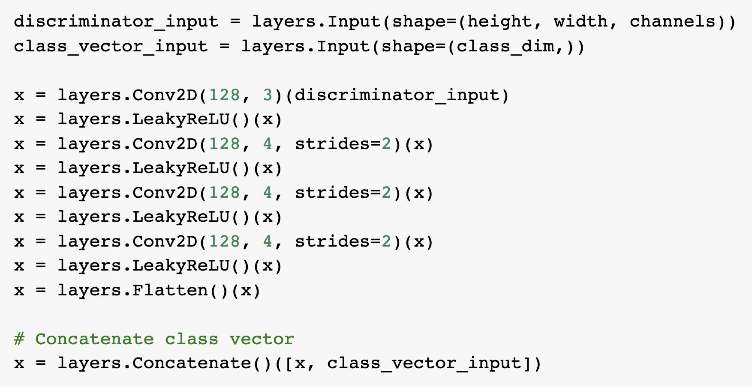
Conditional GAN Discriminator

Slide 19
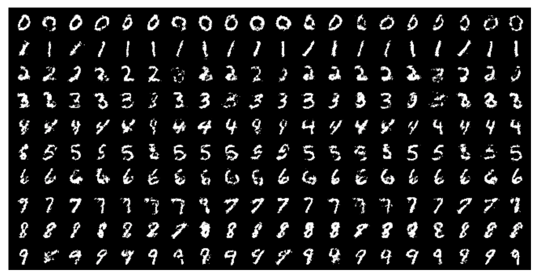
CGAN for mnist

Slide 20
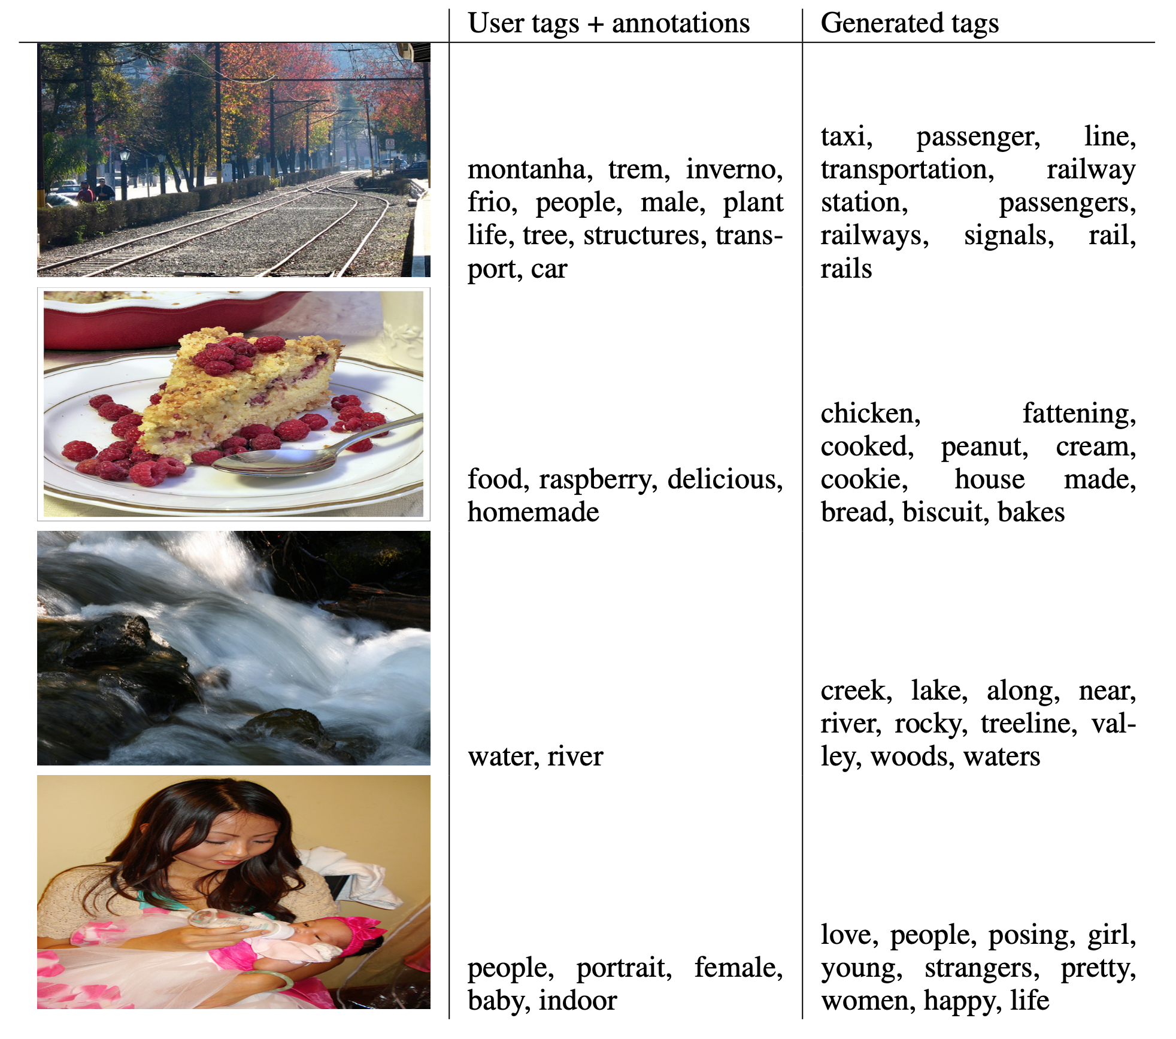
CGAN for automated tagging of images

Slide 21
Thank you! Víctor Uc Cetina victoruccetina@gmail.com

